Slide 1

MANDOB
Business is never easier
*Strongly recommended to watch the Mandob motion graphics video

Slide 2
Speaker introduction
With a high fidelity to our community, and for the mass prosperity plans that our dear country is heading. For the sake of investment and a better commercial economic era.
For paying back what our beloved faculty taught us.
Mandob team is here to introduce a revolutionary project for a better business life.

Slide 3


Slide 4

Application introduction
Boost Ecommerce and make it the easiest, safest, and most profitable way to start or manage a business.
Software, algorithms and analytics for business management.
Boosting investments
Connecting multiple stake-holders in a better environment
E-COMMERCE
MANDOB

Slide 5

Application Goal
Invest in new business.
Create more job opportunities.
Mange business and enlarge its capabilities.
Creating connection between provider and consumer.
E-COMMERCE
MANDOB

Slide 6
Mandob is expecting Two main users category
Business Owner
Startup, business owner, investor
Product & service provider
Wholesaler, broker, Finishing work suppliers, Hardware suppliers, or working hands

Slide 7
New Users Key Activities
Business Owner
Sign in & Data Fill (provide information about them and their business interests)
Product & service provider
Fill data of what they are selling ? what services they provide ? details like unit price, wholesale price, preparation time, units available and more

Slide 8
We have in Mandob’s database all the data entered by users.
Magic of algorithms will happen and everything will be categorized and stored so buyers can feel free to customize services bundles they need.

Slide 9

Mandob contains two main dashboards
Business Owner Dashboard
Product & service provider Dashboard
With simple and easy to use design, User Will feel Free and comfortable to navigate through products and services offered, manage their business and more.

Slide 10
Mandob is available everywhere
Mandob is cross-platform based so we don’t want your dream investment to depend on a bitten apple
Web
Android
IOS

Slide 11
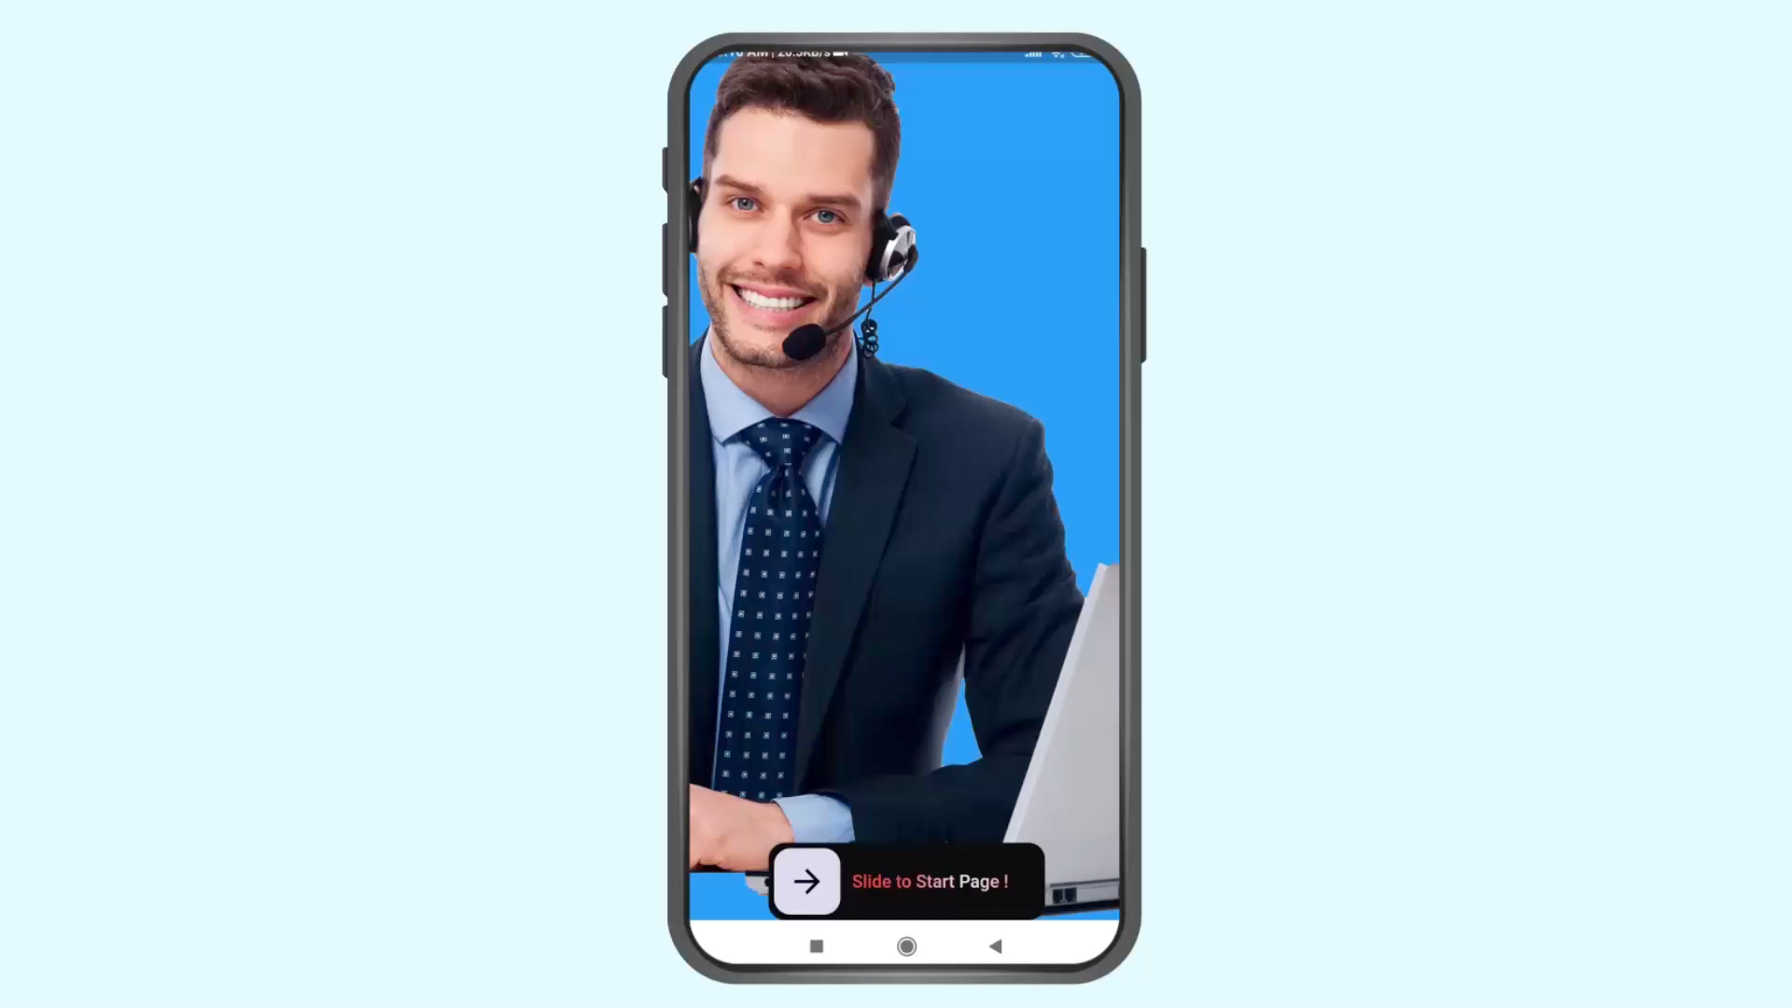
( This Is Video For Demo )

Slide 12
Mandob services for business owner
Choose store location from map
Request customized finishing work
Request customized hardware and store set-up products and services
Order products at wholesale price
Monitor all sold and remaining products
Direct connection with service or product provider.
Update notifications for business inquiry
Updated cart for easy navigation
$62,00

Slide 13
Mandob services for Product & Service provider
Add, remove and update products or services they provide.
Review ordered products & services.
Delivery time feature
Direct connection with buyer
Updated notifications for easier delivery

Slide 14

Future Work
For investor.
Link Mandob system to cashier to monitor sales
Monitor all sold and remaining products
Rate Sellers and review others ratings
Auto order out of stock products
View analytics of most sold products and other customers preferences.
business intelligence analytics that will help managing store.
For provider.
Review delivery terms and agreements.
view clients given ratings.
View analytics of customers preferences
Sponsor, Reach and Sell.
business intelligence analytics to boost selling products and services

Slide 15



THANK YOU
Mandob is so happy that you made it here !

